Slide 1

Estimation of an NBA Player’s Impact on his Team’s Chances of Winning Deshpande | Sameer k | Jensen | Shane T
Aderinto Adesijibomi
Department of Computer and Information Science
Linkoping University

Slide 2
Overview
Basketball the game
Background
Box Score Performance Metrics
Bayesian Approach
Methodology
Results
Discussion

Slide 3
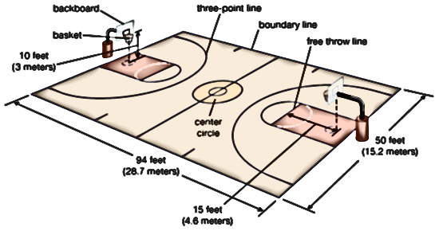
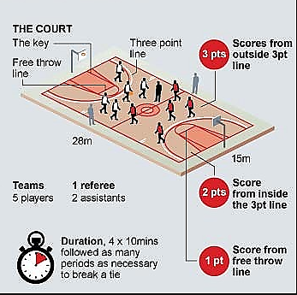
Basketball The Game
Score points
3 points
2 points
1 point
Duration
4 x 10mins
Additional times
Players
5 Home Team Players
5 Away Team Players

Slide 4
Background
Estimation of a player’s relevance is a key performance indicator in asserting player contributions to the win probability in any basketball game.
Linear combination box score metrics like efficiency, player efficiency ratings, defensive player rating have been used to quantify player contributions to basket ball games.
Box score metrics lack the ability quantify each players contributions as a proability of other players on the court.
How can we show each player effect as a probability of other players partial contributions in every game using Bayesian regression.

Slide 5
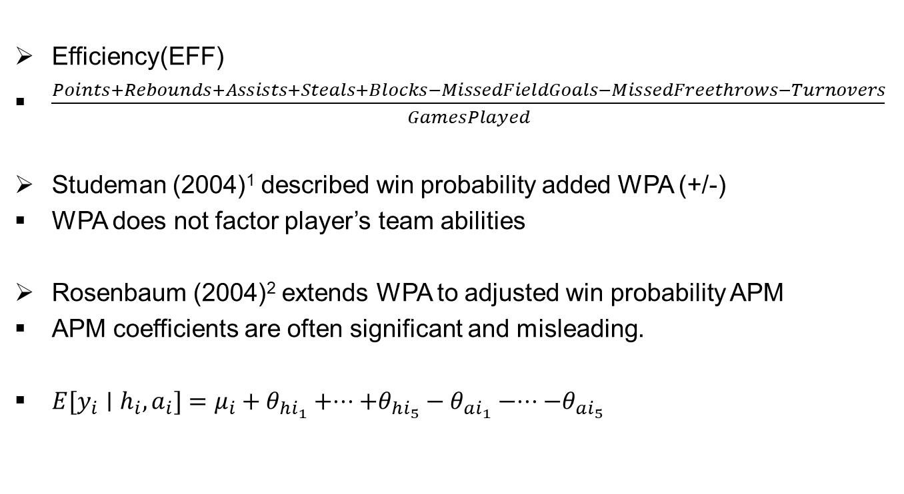
Box Score Performance Metrics
Efficiency(EFF)
$\frac{Points+Rebounds+Assists+Steals+Blocks−MissedFieldGoals−MissedFreethrows−Turnovers}{GamesPlayed}$
Studeman (2004)¹ described win probability added WPA (+/-)
WPA does not factor player’s team abilities
Rosenbaum (2004)² extends WPA to adjusted win probability APM
APM coefficients are often significant and misleading.
$E[y_{i}∣h_{i},a_{i}]=μ_{i}+θ_{hi_{1}}+⋅⋅⋅+θ_{hi_{5}}−θ_{ai_{1}}−⋅⋅⋅−θ_{ai_{5}}$
¹ The One about Win Probability.” Hardball Times.
² Measuring How NBA Players Help Their Teams Win.” 82Games. Com (Http://Www. 82games. Com/Comm30. Htm), 4–30.
Notes:
Studeman, D. 2004. “The One about Win Probability.” Hardball Times.

Slide 6
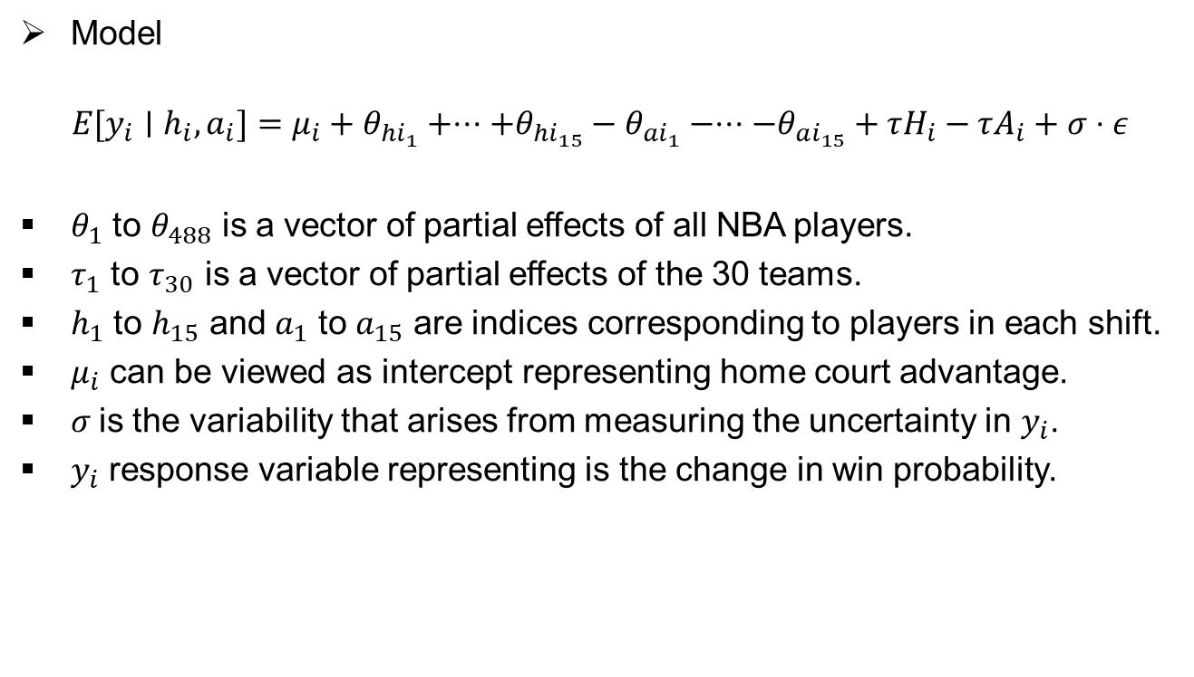
Bayesian Approach
Model
$$E[y_{i}∣h_{i},a_{i}]=μ_{i}+θ_{hi_{1}}+⋅⋅⋅+θ_{hi_{15}}−θ_{ai_{1}}−⋅⋅⋅−θ_{ai_{15}}+τH_{i}−τA_{i}+σ⋅ε$$
$θ_{1}$ to $θ_{488}$ is a vector of partial effects of all NBA players.
$τ_{1}$ to $τ_{30}$ is a vector of partial effects of the 30 teams.
$h_{1}$ to $h_{15}$ and $a_{1}$ to $a_{15}$ are indices corresponding to players in each shift.
$μ_{i}$ can be viewed as intercept representing home court advantage.
$σ$is the variability that arises from measuring the uncertainty in $y_{i}$.
$y_{i}$ response variable representing is the change in win probability.

Slide 7
Methodology
Data
play-by-play data obtained from ESPN 2006-2007 to 2012–2013 season which comprises of 8 seasons.
15% of the data were either missing or incomplete.
A typical game consits of 31 shifts.
Estimate win probability as a function of lead points and time duration.
Change in win probability is regressed onto players on the court.

Slide 8
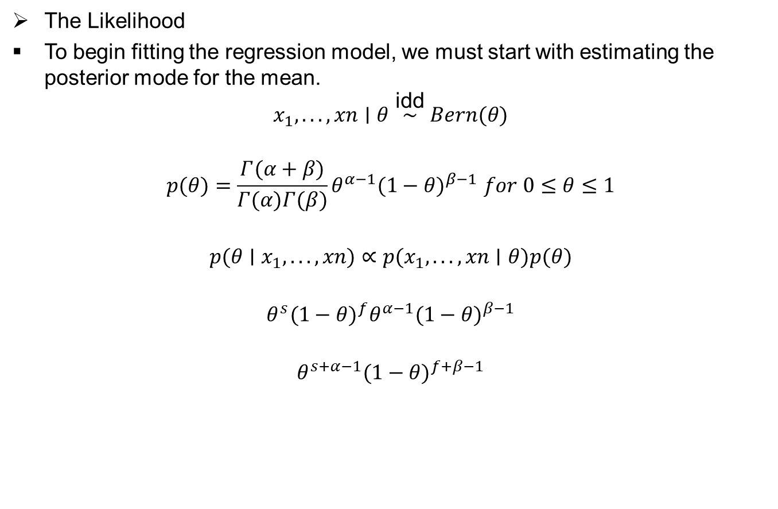
Estimating The Win Probability
The Likelihood
To begin fitting the regression model, we must start with estimating the posterior mode for the mean.
$$x_{1},...,xn∣θ\overset{\text{idd}}{∼}Bern(θ)$$
$$p(θ)=\frac{Γ(α+β)}{Γ(α)Γ(β)}θ^{α−1}(1−θ)^{β−1} for 0≤θ≤1$$
$$p(θ∣x_{1},...,xn)∝p(x_{1},...,xn∣θ)p(θ)$$
$$θ^{s}(1−θ)^{f}θ^{α−1}(1−θ)^{β−1}$$
$$θ^{s+α−1}(1−θ)^{f+β−1}$$
Wegmann, Berti. 2022. Bayesian Learning: Bayesian Model Comparison. Variable Selection. Department of Computer; Information Science Linkoping University.
Notes:
To begin fitting the regression model, we must start with estimating the posterior mode for the mean, which will be the probability that the home team wins the game leading with change in points score denoted by L points and time duration T seconds denoted by P and by placing a conjugate Beta$(α,β)$prior on data and estimate the posterior mean.

Slide 9

Estimating The Win Probability
The Likelihood
$$logP\left(θ ∣ x\right)=log⋅θ\left(s+α−1\right)×log⋅\left(1−θ\right)$$
$$\frac{∂logP(θ∣x)}{∂θ}=\frac{s+α−1}{θ}−\frac{f+β−1}{1−θ}=0$$
$$\hat{θ}=\frac{α+s−1}{α+β+n−2}$$
$$\hat{θ}=\frac{α+s}{α+β+n}$$
$${\hat{P}}_{T,L}=\frac{n_{T,L}+α_{T,L}}{N_{T,L}+α_{T,L}+β_{T,L}}$$
Wegmann, Berti. 2022. Bayesian Learning: Bayesian Model Comparison. Variable Selection. Department of Computer; Information Science Linkoping University.

Slide 10
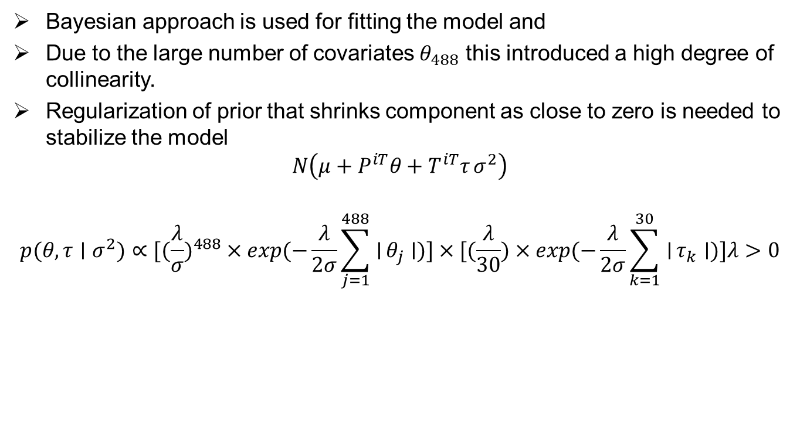
Regularization of Prior
Bayesian approach is used for fitting the model and
Due to the large number of covariates $θ_{488}$ this introduced a high degree of collinearity.
Regularization of prior that shrinks component as close to zero is needed to stabilize the model
$$N\left(μ+P^{iT}θ+T^{iT}τ σ^{2}\right)$$
$$p(θ,τ∣σ^{2})∝[(\frac{λ}{σ})^{488}×exp(−\frac{λ}{2σ}\sum_{j=1}^{488}{∣}θ_{j}∣)]×[(\frac{λ}{30})×exp(−\frac{λ}{2σ}\sum_{k=1}^{30}{∣}τ_{k}∣)]λ>0$$

Slide 11
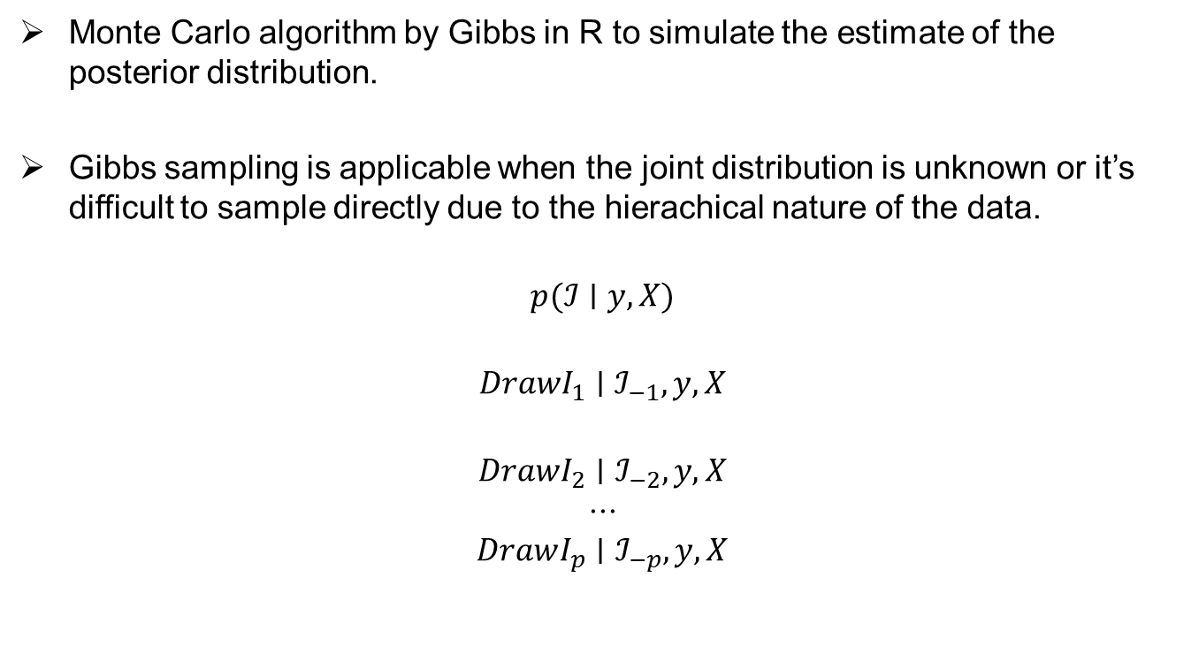
Gibbs Sampler
Monte Carlo algorithm by Gibbs in R to simulate the estimate of the posterior distribution.
Gibbs sampling is applicable when the joint distribution is unknown or it’s difficult to sample directly due to the hierachical nature of the data.
$$p(ℐ∣y,X)$$
$$DrawI_{1}∣ℐ_{−1},y,X$$
$$DrawI_{2}∣ℐ_{−2},y,X$$
$$⋅⋅⋅$$
$$DrawI_{p}∣ℐ_{−p},y,X$$

Slide 12
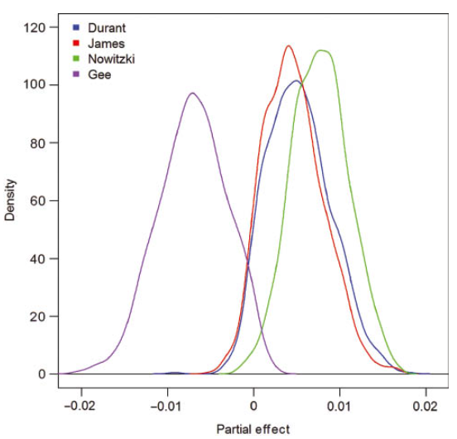

Results
Posterior Analysis
Kelvin Durant
Lebron James
Nowitzki
Gee
variability of $y_{i}$ is within the range of [-0.2, 0.2]

Slide 13
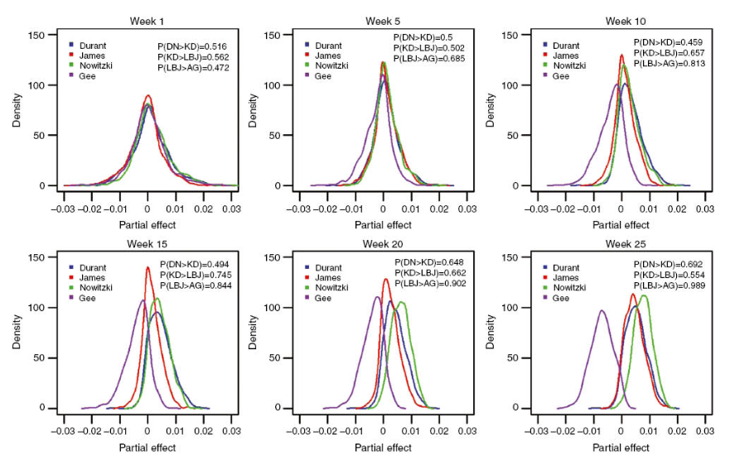
Approximate posterior density of kelvin Durant, Lebron James, Dirk Nowitzki and Alonzo Gee as season progresses

Slide 14
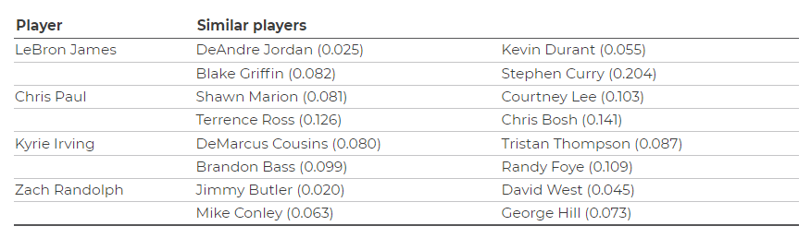
Comparing Players
Directly comparing the partial effects of players is not possible because of the multivariate characteristics of the contexts in which they played.
Mahalanobis distance between leverage profiles of each player was computed to show players with similar leverage profile.

Slide 15
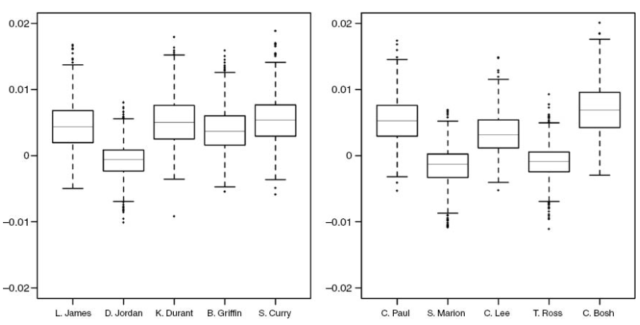
Comparison box plots of partial effects of players with similar leverage profiles.

Slide 16
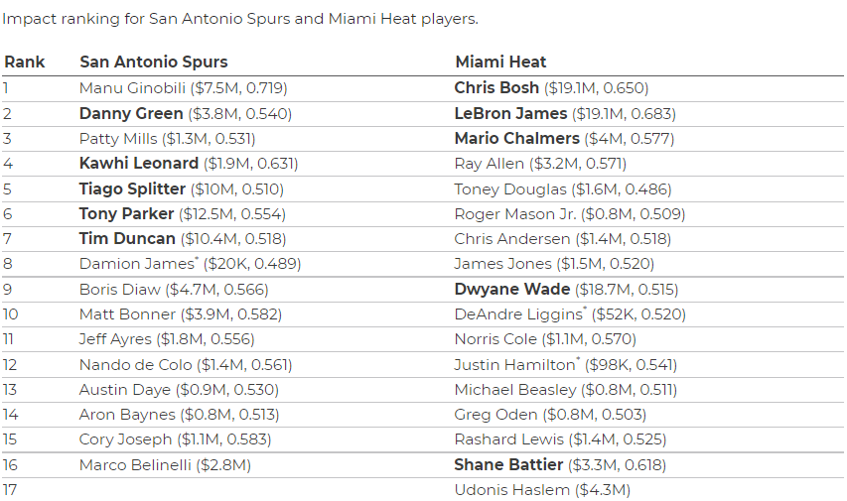
Impact ranking of players with estimated probabilities and salaries

Slide 17
Discussion
Combination of Bayesian and linear regression, provides performance of a player conditional on other players on the court.
This performance indicators when combined with traditional box score metric can provide an holistic view of the whole team’s performance
Observed estimates are inconsistent due to varying player context, thus it cannot be used for predicting player performance.

